Slide 1

2022 Beef Carcass Awards
Placer County Fair
Nevada County Fair
Gold Country Fair
Presented by
Dan Macon, Livestock and Natural Resources Advisor
UC Cooperative Extension – Placer/Nevada/Sutter/Yuba
December 6, 2022

Slide 2
2022 Beef Carcass Contest Sponsors
Tahoe Cattlemen’s Association
Placer-Nevada CattleWomen
California Beef Cattle Improvement Association
UC Cooperative Extension

Slide 3
2022 Beef Carcass Contest Criteria
 | Carcass of Merit | Gold Seal
Hot Carcass Weight (lbs) | 600-1000 lbs | 650-900 lbs
Quality Grade (minimum) | Choice(-) | Choice
Yield Grade | 3.99 or less | 2.99 or less
Standards developed by the
California Beef Cattle Improvement Association

Slide 4
Carcass Data Collection
Carcass yield and quality data are collected at the point of harvest by a grader provided by the processor.
While experienced carcass graders are consistent across animals/lots, there is some subjectivity in carcass evaluation.
Data reflects quality/yield AT TIME OF HARVEST.
2022 Carcass Data
  Placer County Fair – Premium California Foods (Winton, CA)
  Nevada County Fair & Gold Country Fair – Los Baños Abattoir (Los Baños, CA)

Slide 5
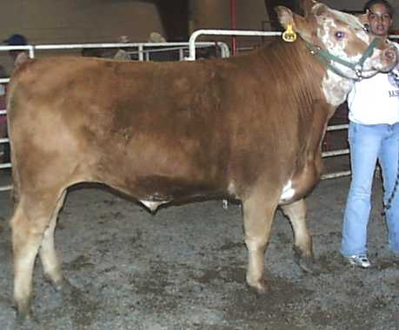
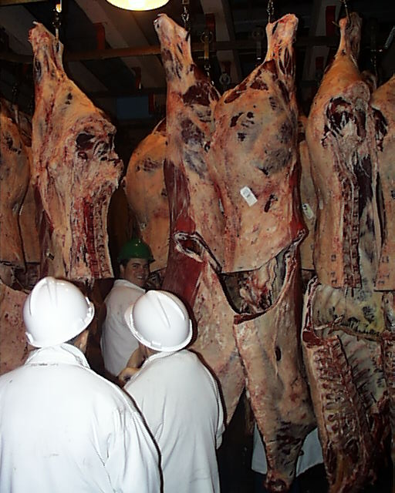
Dressing Percentage
Dressing % = Hot Carcass Weight / Live Weight
Notes:
Dressing percent is the Hot Carcass Weight / Live Weight X 100. A higher dressing percentage means there is a higher yield of meat.

Slide 6
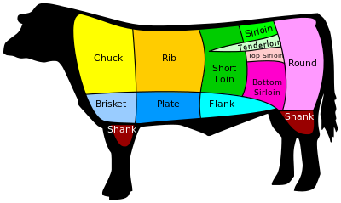
Factors Affecting Dressing %
Gut fill
Muscling
Amount of fat (external and KPH fat)
Weight of hide, head, feet, and horns
GOAL: 60% for grain-finished steer.

Slide 7
Beef Quality Grades
Beef carcass quality grading is based on:
(1) degree of marbling
(2) degree of maturity.
A quality grade is a composite evaluation of factors that affect palatability of meat (tenderness, juiciness, and flavor). These factors include:
Carcass maturity
Firmness, texture, and color of lean
Amount and distribution of marbling within the lean

Slide 8
Maturity
Carcass Maturity | Approximate Live Age
A | 9-30 months
B | 30-42 months
C | 42-72 months
D | 72-96 months
E | 96+ months
Maturity refers to the physiological age of the animal rather than the chronological age. Because the chronological age is virtually never known, physiological maturity is used; the indicators are:
Bone characteristics
Ossification of cartilage
Color and texture of ribeye muscle
Notes:
All the steers are A maturity.

Slide 9
Quality – Maturity and Marbling
“Quality” means “how good” – as in flavor and tenderness.
Beef carcasses are assigned quality grades:
Prime
Choice
Select
Standard
Quality grades are determined by the amount of marbling detected in a cross-section of the ribeye (loin) muscle and an overall evaluation of the fat cover on the animal.

Slide 10
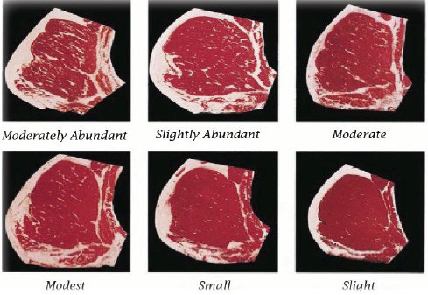
Marbling Scores
Prime
Prime
Choice +
Choice
Choice -
Select
Notes:
This shows the difference in amount marbling by marbling scores. Slight is associated with the Select grade. Small is associated with the Choice minus grade. Modest is associated with the Choice grade. Moderate is associated with the Choice plus grade. The abundant scores are associated with the Prime grade.

Slide 11
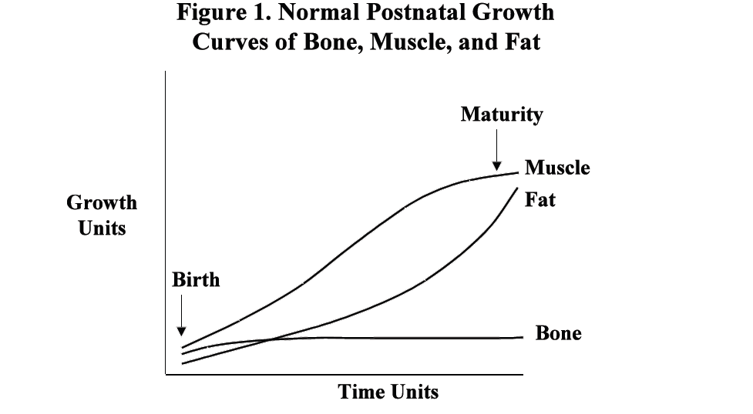
Marbling
Marbling fat is the last thing a steer puts on and the first thing it loses if stressed.
Notes:
This shows that fat is the last thing the animal puts on, especially marbling. The calf is pretty much born with all the bone it will have. Growth at first is all muscle. As the calf gets older, it starts to put on fat. Marbling fat is the last thing a steer puts on and the first thing it loses if stressed.

Slide 12
Dark Cutters
Dark-cutting is a condition in cattle that makes muscles appear very dark. This condition is caused by a decrease in the amount of glycogen in the muscle prior to slaughter. Glycogen is the product of the muscle that is converted to lactic acid, which decreases the pH of the muscle. This decrease in pH causes the muscle to be bright cherry-red.
If there is not enough glycogen to decrease the pH in the muscle, then the muscle will have a dark appearance to the lean surface. Consumers are not willing to buy dark beef and thus the value is decreased.
Producers and feeders can help to decrease this loss to the beef industry by decreasing the amount of stress on cattle.
Notes:
There were 2 steers from the Gold Country Fair and one steer from the Nevada County Fair that were dark cutters.

Slide 13
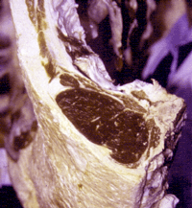
Sources of Stress in Cattle
What are some potential sources of stress in YOUR cattle?

Slide 14
Yield Grade
Yield Grade means “how much” – as in how much meat a carcass produces.
Carcasses are assigned yield grade numbers (1-5). Lower numbers indicate carcasses that produce the most meat.

Slide 15
How Is Yield Grade Determined?
Amount of external fat – Indicates the amount of carcass trimming needed (more trimming = more expense)
Amount of kidney, pelvic, and heart fat
Ribeye area – Indicator of total amount of muscle in the carcass
Hot Carcass Weight

Slide 16
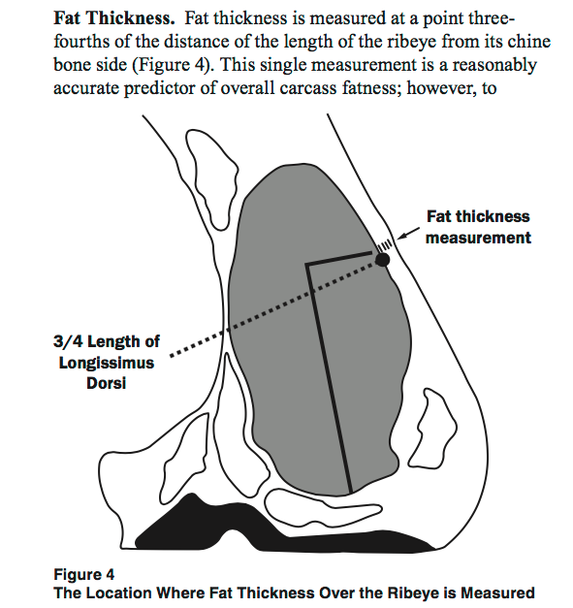

Slide 17
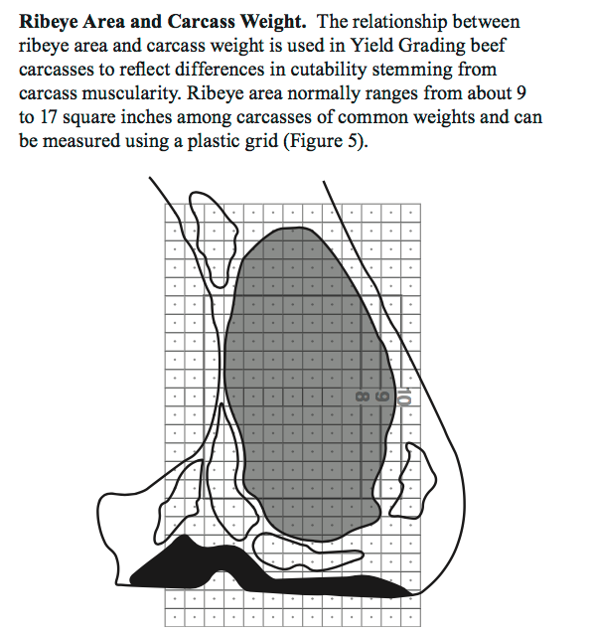
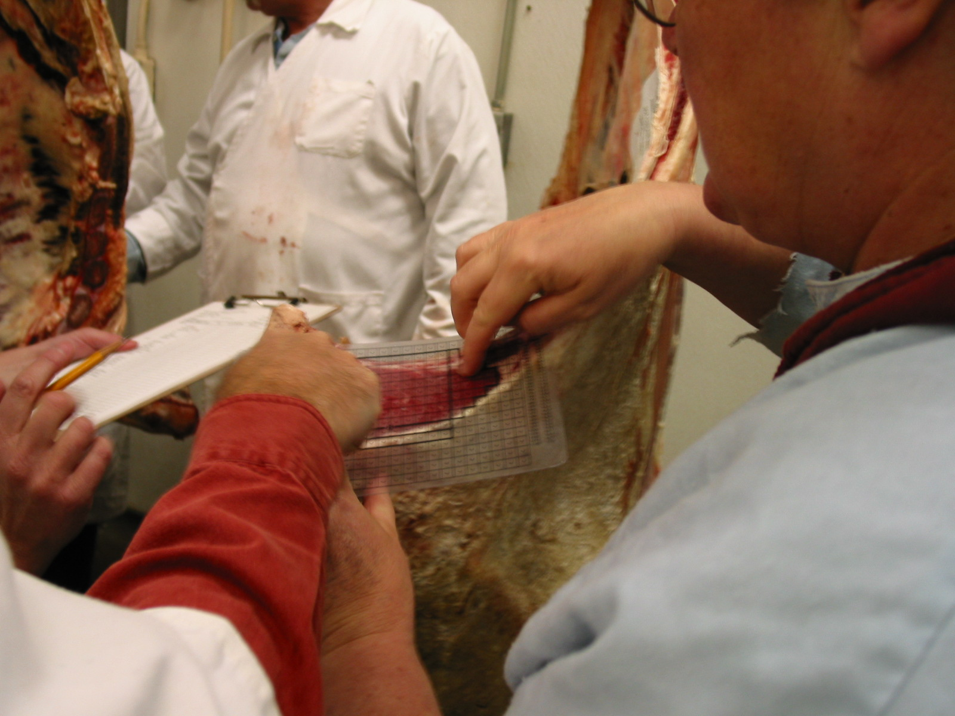
Yield Grade - Calculating Ribeye Area
Notes:
This shows putting a dot grid on the ribeye to determine area in square inches.

Slide 18
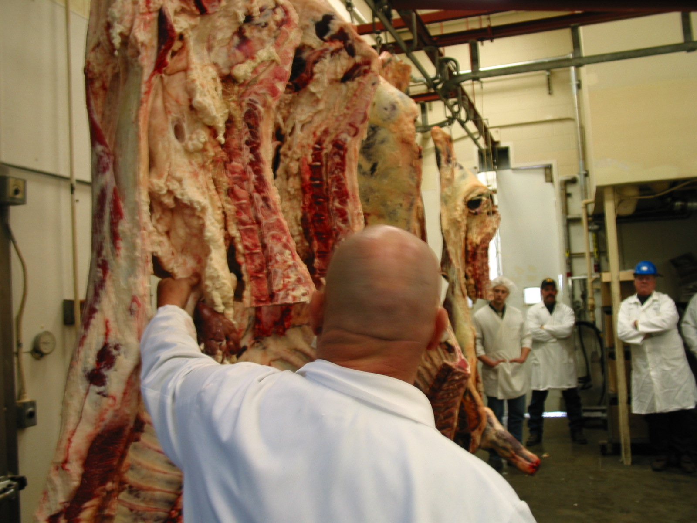
Yield Grade - % Kidney, Pelvic, Heart Fat
Fat deposits around the kidney and heart, and in the pelvic cavity, are typically left in the carcass during the slaughter process and affect carcass cutability. In most carcasses, KPH fat represents about 1-4 percent of the total carcass weight.

Slide 19
Yield Grade: Estimate of Cutability
Yield Grade | Cutability
1.0 | <52.3%
2.0 | 50-52.3%
3.0 | 47.7-50.0%
4.0 | 45.4-47.7%
5.0 | <45.4%
Cutability measures the percentage of retail cuts in a carcass.
For example, an 800 lb YG2 carcass will have as much as 55 lbs of additional retail product when compared with an 800 lb YG5 carcass!

Slide 20
2022 Results Summary
 | Placer County Fair | Nevada County Fair | Gold Country Fair
Number of Steers Exhibited | 7 | 50 | 16
Average Hot Carcass Weight (lbs) | 785.0 lbs | 797.7 lbs | 828.3
Average Live Weight (lbs) | 1,285.9 lbs | 1,302.0 lbs | 1,342.3 lbs
Average Dressing Percentage | 61.0% | 61.3% | 61.6%
Average Ribeye Area | 13.0 sq in | 14.9 sq in | 14.7 sq in
Average Backfat Thickness | 0.51 in | 0.47 in | 0.51 in
Average KPH Fat | 2.1% | 3.0% | 3.3%
Average Yield Grade | 3.1 | 2.6 | 2.9
Prime (#) | 0 | 1 | 0
Choice (#) | 1 | 35 | 12
Select+ (#) | 5 | 8 | 0
Select- (#) | 0 | 6 | 4
Standard (#) | 1 | 0 | 0
Dark Cutters (#) | 0 | 0 | 0
Percent Choice or Higher | 14% | 72% | 75%
Percent Select+ or Higher | 86% | 88% | 75%

Slide 21
Choice-Select Spread
 | Choice | Select
Dec 2, 2022 Cutout Values (based on HCW) | $234.30/cwt | $209.96/cwt
Total Carcass Value (803.2 lbs HCW) | $1,881.90 | $1,686.40
Difference in Value | $195.90
73 Steers @ 803.2 lbs HCW (total value) | $137,378.52 | $123,107.11
Difference in Total Value | $14,271.42

Slide 22
Retail Cuts – how does a carcass break down?
 | Placer | Nevada | Gold Country
Average HCW | 785.0 lbs | 797.7 lbs | 828.3 lbs
Fat/Bone (21%) | 164.9 lbs | 167.5 lbs | 173.9 lbs
Low Priced Cuts (53.6%) | 442.0 lbs | 449.1 lbs | 466.3 lbs
High Priced Cuts (25.4%) | 199.4 lbs | 202.6 lbs | 210.4 lbs

Slide 23
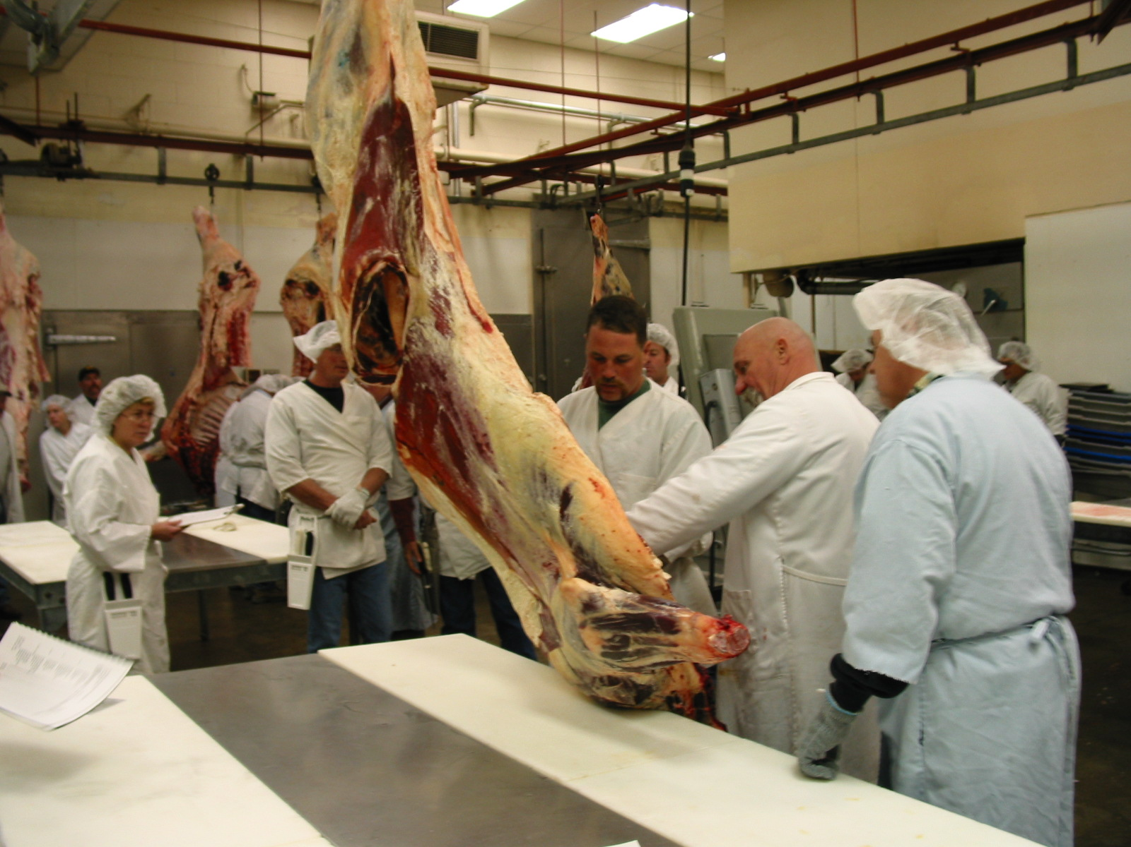
Half of Beef
Notes:
Start with all of this- 2 halves = 671 lbs

Slide 24
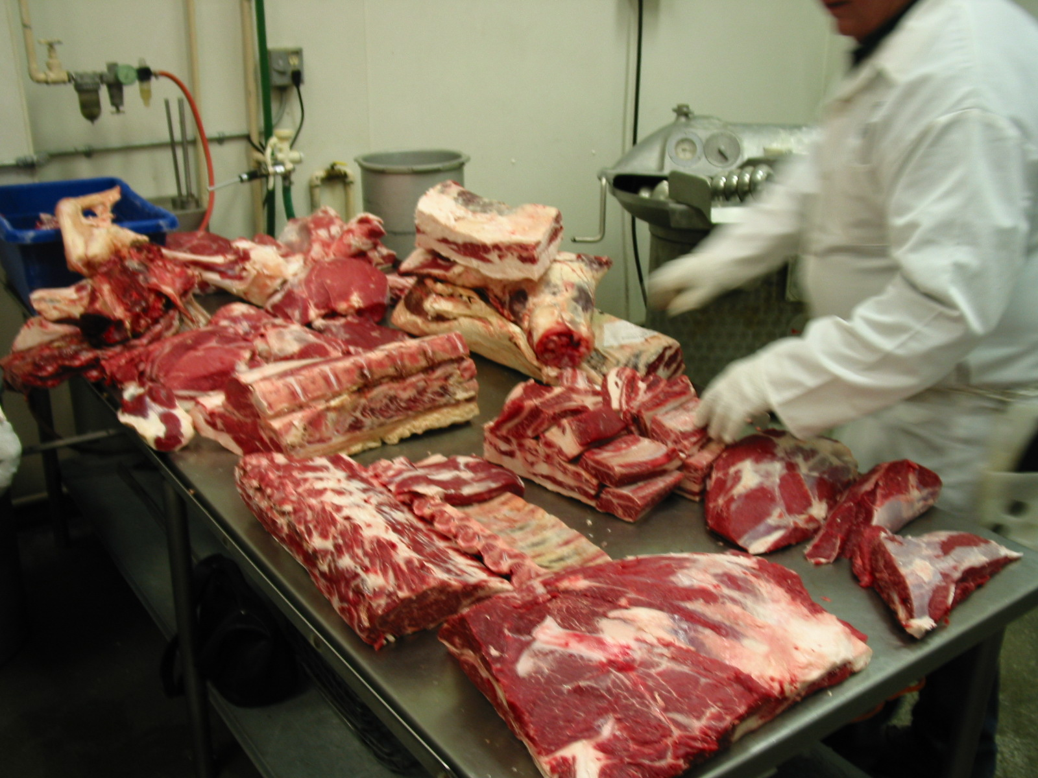
Cuts of Beef
Notes:
You end up with this – 304 lbs of cuts of beef

Slide 25
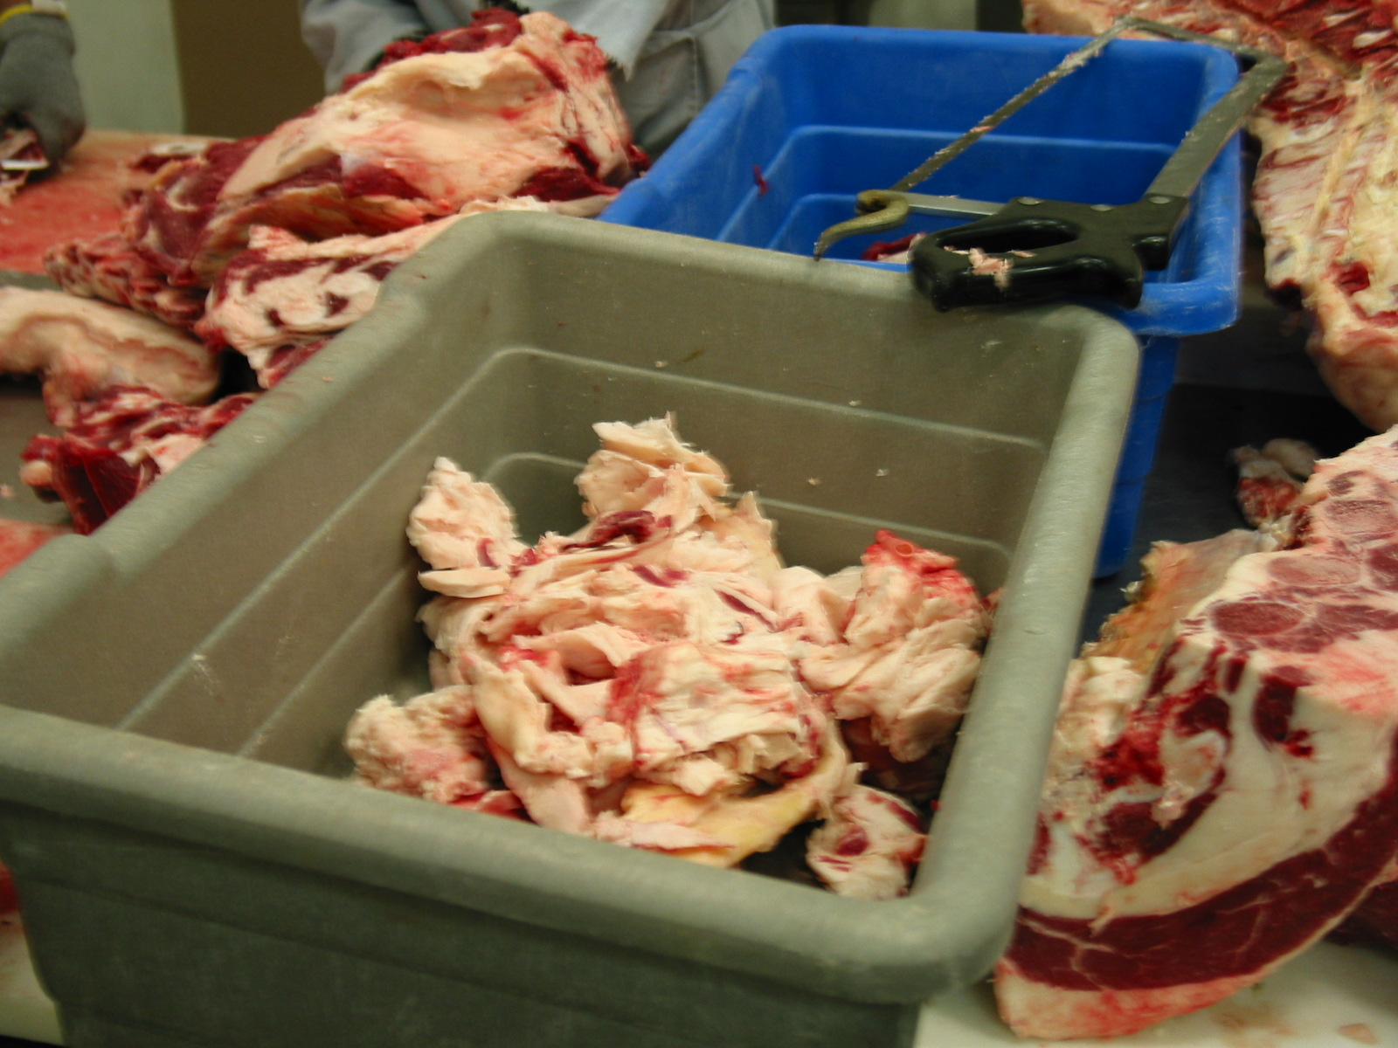
Fat Bin
Notes:
And this – 138 lbs of fat and bone

Slide 26
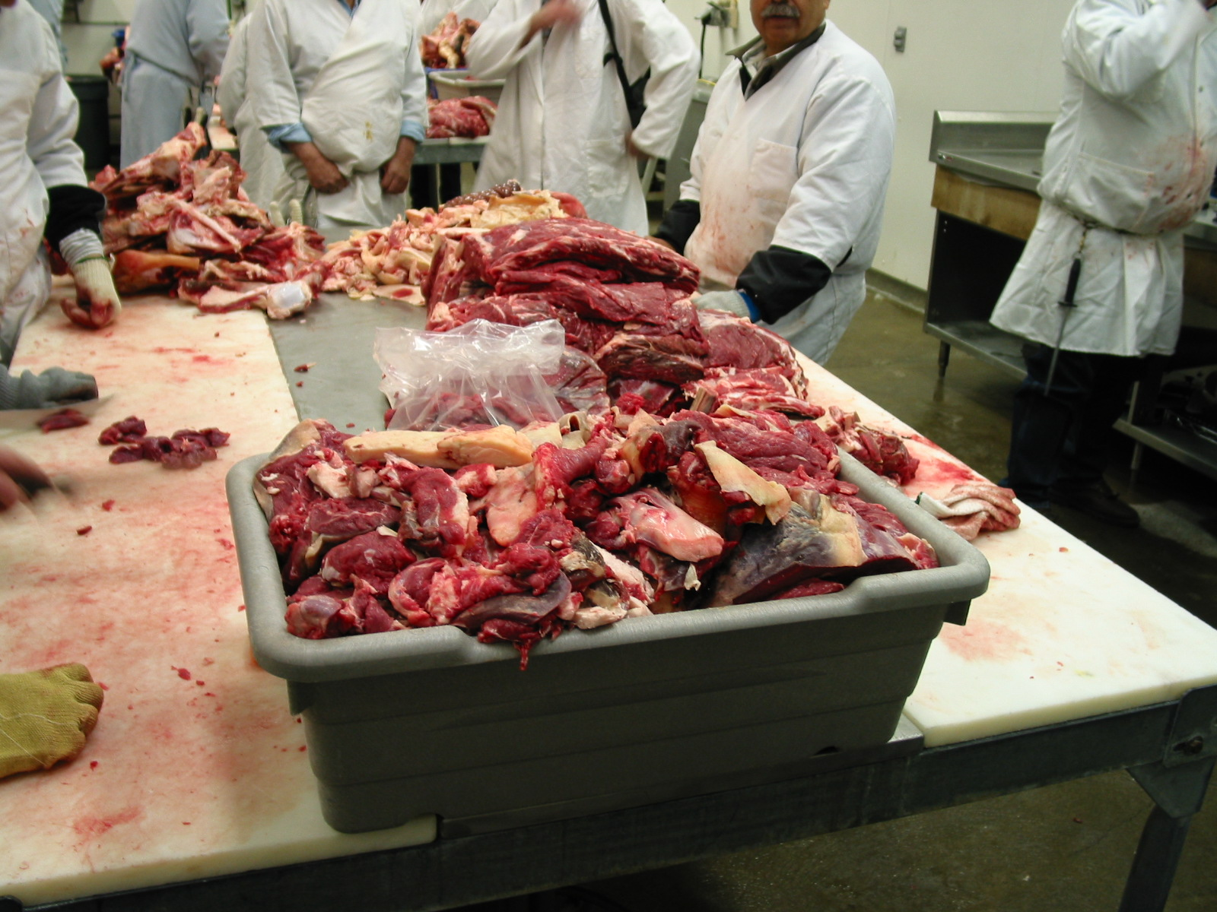
Trim
Notes:
And this – 229 lbs of trim

Slide 27
2022 Beef Carcass Contest Criteria
 | Carcass of Merit | Gold Seal
Hot Carcass Weight (lbs) | 600-1000 lbs | 650-900 lbs
Quality Grade (minimum) | Choice(-) | Choice
Yield Grade | 3.99 or less | 2.99 or less
Standards developed by the
California Beef Cattle Improvement Association

Slide 28
2022 Beef Carcass Awards (finally!)
Each Gold Seal Carcass will receive a certificate and a $100 check from TCA!
Each Carcass of Merit recipient will receive a certificate and a $50 check from TCA!
The top 3 carcasses from each fair will receive the actual premium they would have received on the CBCIA grid.
The TOP carcass from each fair will receive a buckle!

Slide 29
2022 Carcass of Merit Winners
Placer County Fair | Nevada County Fair |  | Gold Country Fair
 | Gerald Andres | Logan Mackey | Ava Beidler
 | Preston Andres | Lucas Mackey | Macie Gleason
 | Cody Baker | Layla O’Connor | William Gleason
 | Mason Block | Lauren Riebe | Brayden Lomas
 | Morgan Block | Eli Thompson | Hannah Vineyard
 | Sara Borchert | Maddie Thompson | Julia Wittinger
 | Kaizer Chick | Emily Whitman
 | Hailey Clemens
 | Peyton Dorris
 | Bennett Fischer
 | Marydith Fischer
 | Tanner Flaherty
 | Molly Fowler
 | Morgan Fowler
 | Dakota Graham
 | Russell Hansen
 | Jackson Harris

Slide 30
2022 Gold Seal Winners
Placer County Fair | Nevada County Fair | Gold Country Fair
 | Hailey Bannister | Ryder Hartley
 | Samantha Flaherty | Mathew Marino
 | Savannah Hansen | Emilee Miller
 | Leah Helm | Lauren Pineschi
 | Clara Lawless
 | Makayla Magnusen
 | Cole Mertens
 | Cheyanne Painter
 | Blake Simning
 | Tessa Strong

Slide 31
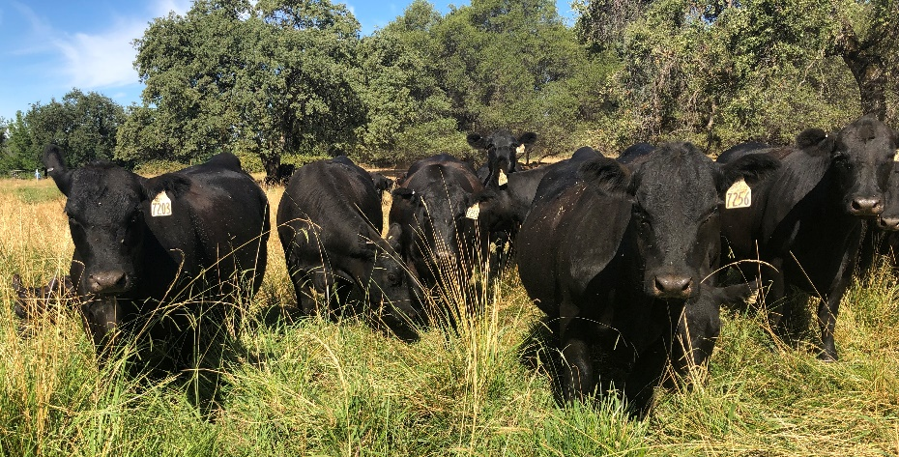
Rate of Gain Contest
Placer and Gold Country Fairs
Sponsored by Placer-Nevada CattleWomen (Marsha Stevens will present awards)
Calculated by dividing weight gain from pre-weight to fair weight by the days on feed.
Why is rate of gain important?

Slide 32
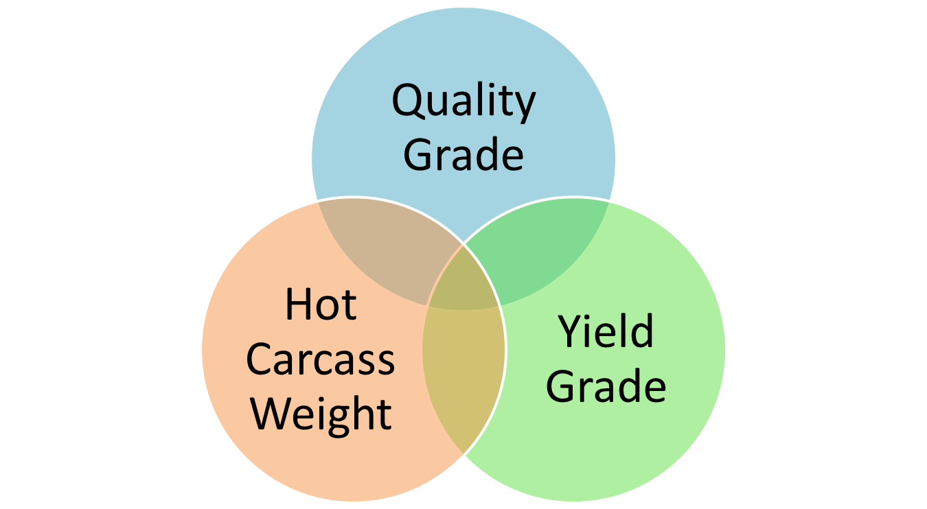
Grid Pricing

Slide 33
2022 CBCIA Beef Pricing Grid
Quality Grade Prime Choice+/Choice Select Standard Dark Cutter | +$20.18 +$5.57 -$23.67 -$34.29 -$35.83
Yield Grade 1.0 – 1.9 2.0 – 2.4 2.5 – 2.9 4.0 – 4.9 5.0 – 5.9 | +$3.58 +$1.77 +$1.38 -$11.23 -$16.85
Hot Carcass Weight 400 – 499 500 – 549 550 – 599 901 – 1000 1001 – 1050 1050 + | -$27.14 -$20.50 -$11.57 -$1.07 -$5.00 -$16.07

Slide 34
2022 Placer County Fair – Top 3
James Segale: $0.00 (Choice-, YG3.8, 820 lbs)
Erica Haddox: -$174.53 (Select+, YG2.8, 783 lbs)
Cooper Maul: -$175.20 (Select+, YG2.3, 800 lbs)

Slide 35
2022 Nevada County Fair – Top 3
Layla O’Connor: $163.66 (Prime-, YG3.5, 811 lbs)
Savanna Hansen: $79.06 (Choice, YG1.0, 864 lbs)
Blake Simning: $69.54 (Choice, YG1.9, 760 lbs)

Slide 36
2022 Gold Country Fair – Top 3
Emilee Miller: $57.75 (Choice, YG2.8, 831 lbs)
Mathew Marino: $57.43 (Choice, YG2.0, 916 lbs)
Lauren Pineschi: $57.27 (Choice+, YG2.5, 824 lbs)

Slide 37
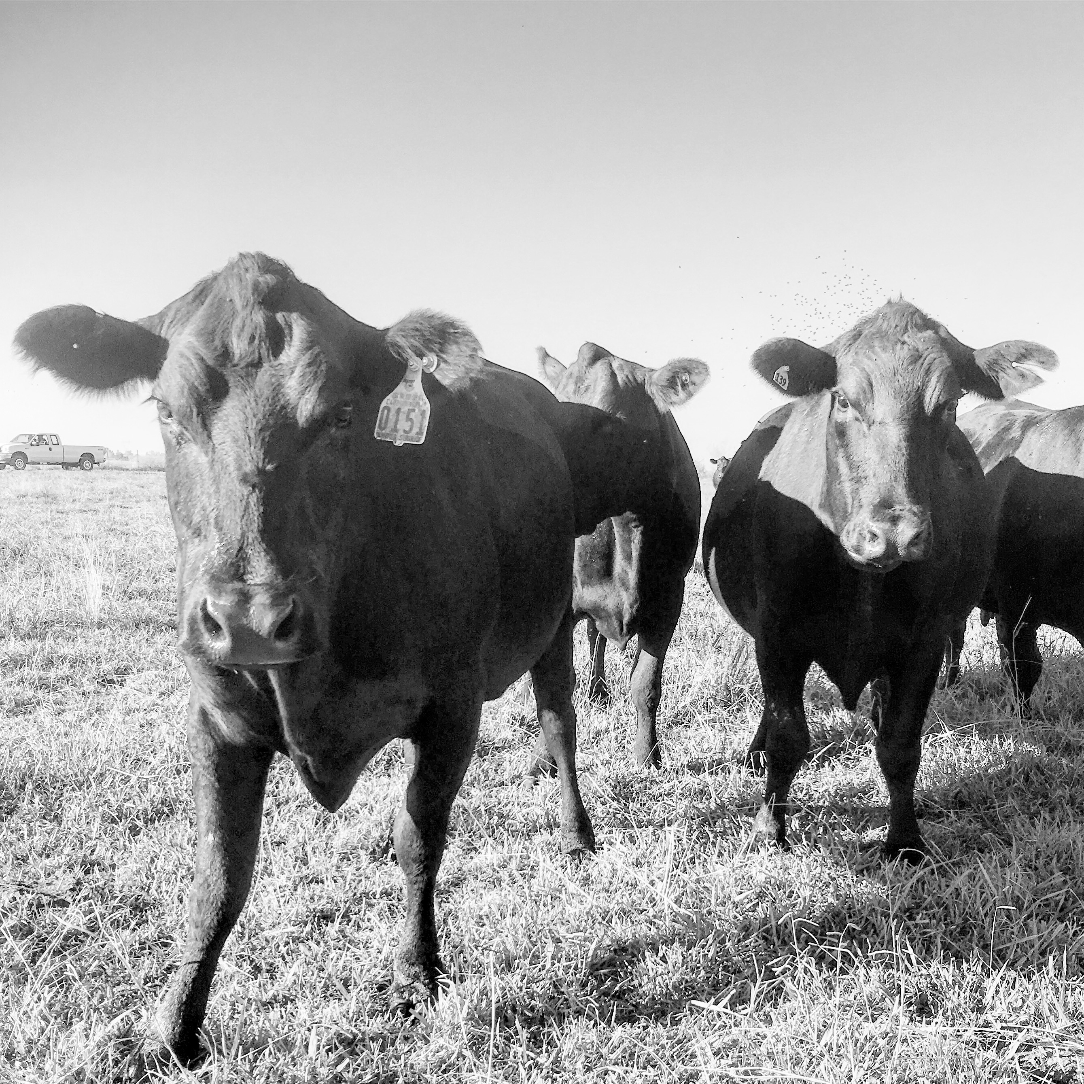
Thank you!
Questions?

